Slide 1

DengAI: Predicting Disease Spread
CS4622 Machine Learning
AltumTek
140007P C. Abeysinghe
140262P L.M. Jayathilake
140674F C.L. Wijayakoon
140684K T.K. Wijesinghe

Slide 2
Outline
Problem
Solution Steps
Results

Slide 3
Problem statement
We need to predict the dengue cases in two cities, given historical data on their weather, climate and past dengue cases.
Dengue kills. We want to be ready to save as many lives as possible.

Slide 4
Solution Procedure
Analyse the Data
Feature
Engineering
Model Construction & Prediction
Model Tuning
Identify & process missing values
Analyse feature importance
Select features
Moving Averages
Time lagging
Quarter-wise breakdown
Negative Binomial regression
Random forest regression
Grid Search

Slide 5
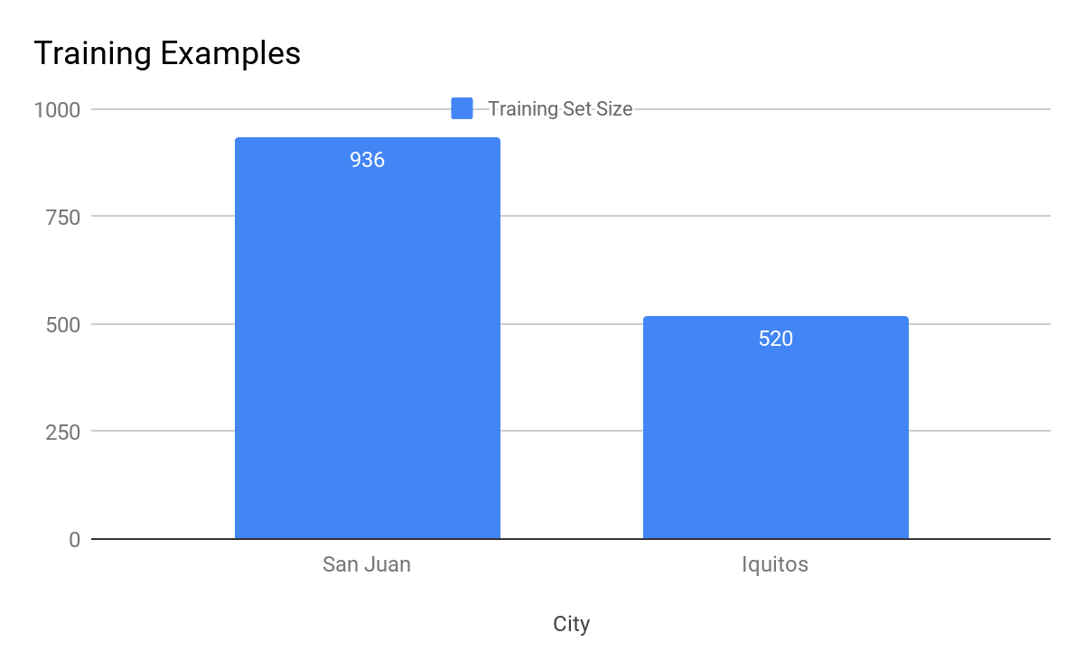
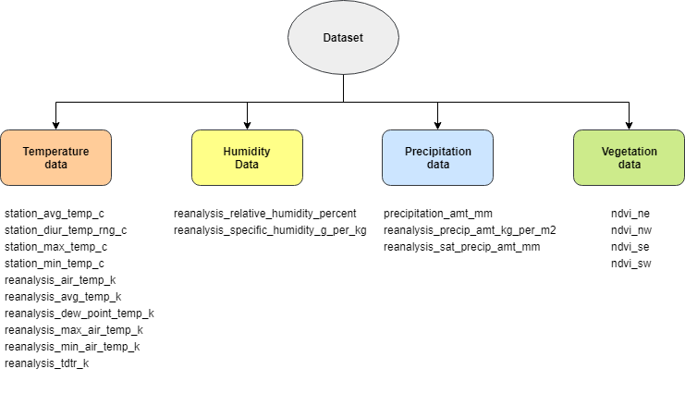
Data from 2 cities
20 features from San Juan of Puerto Rico &
Iquitos of Peru

Slide 6
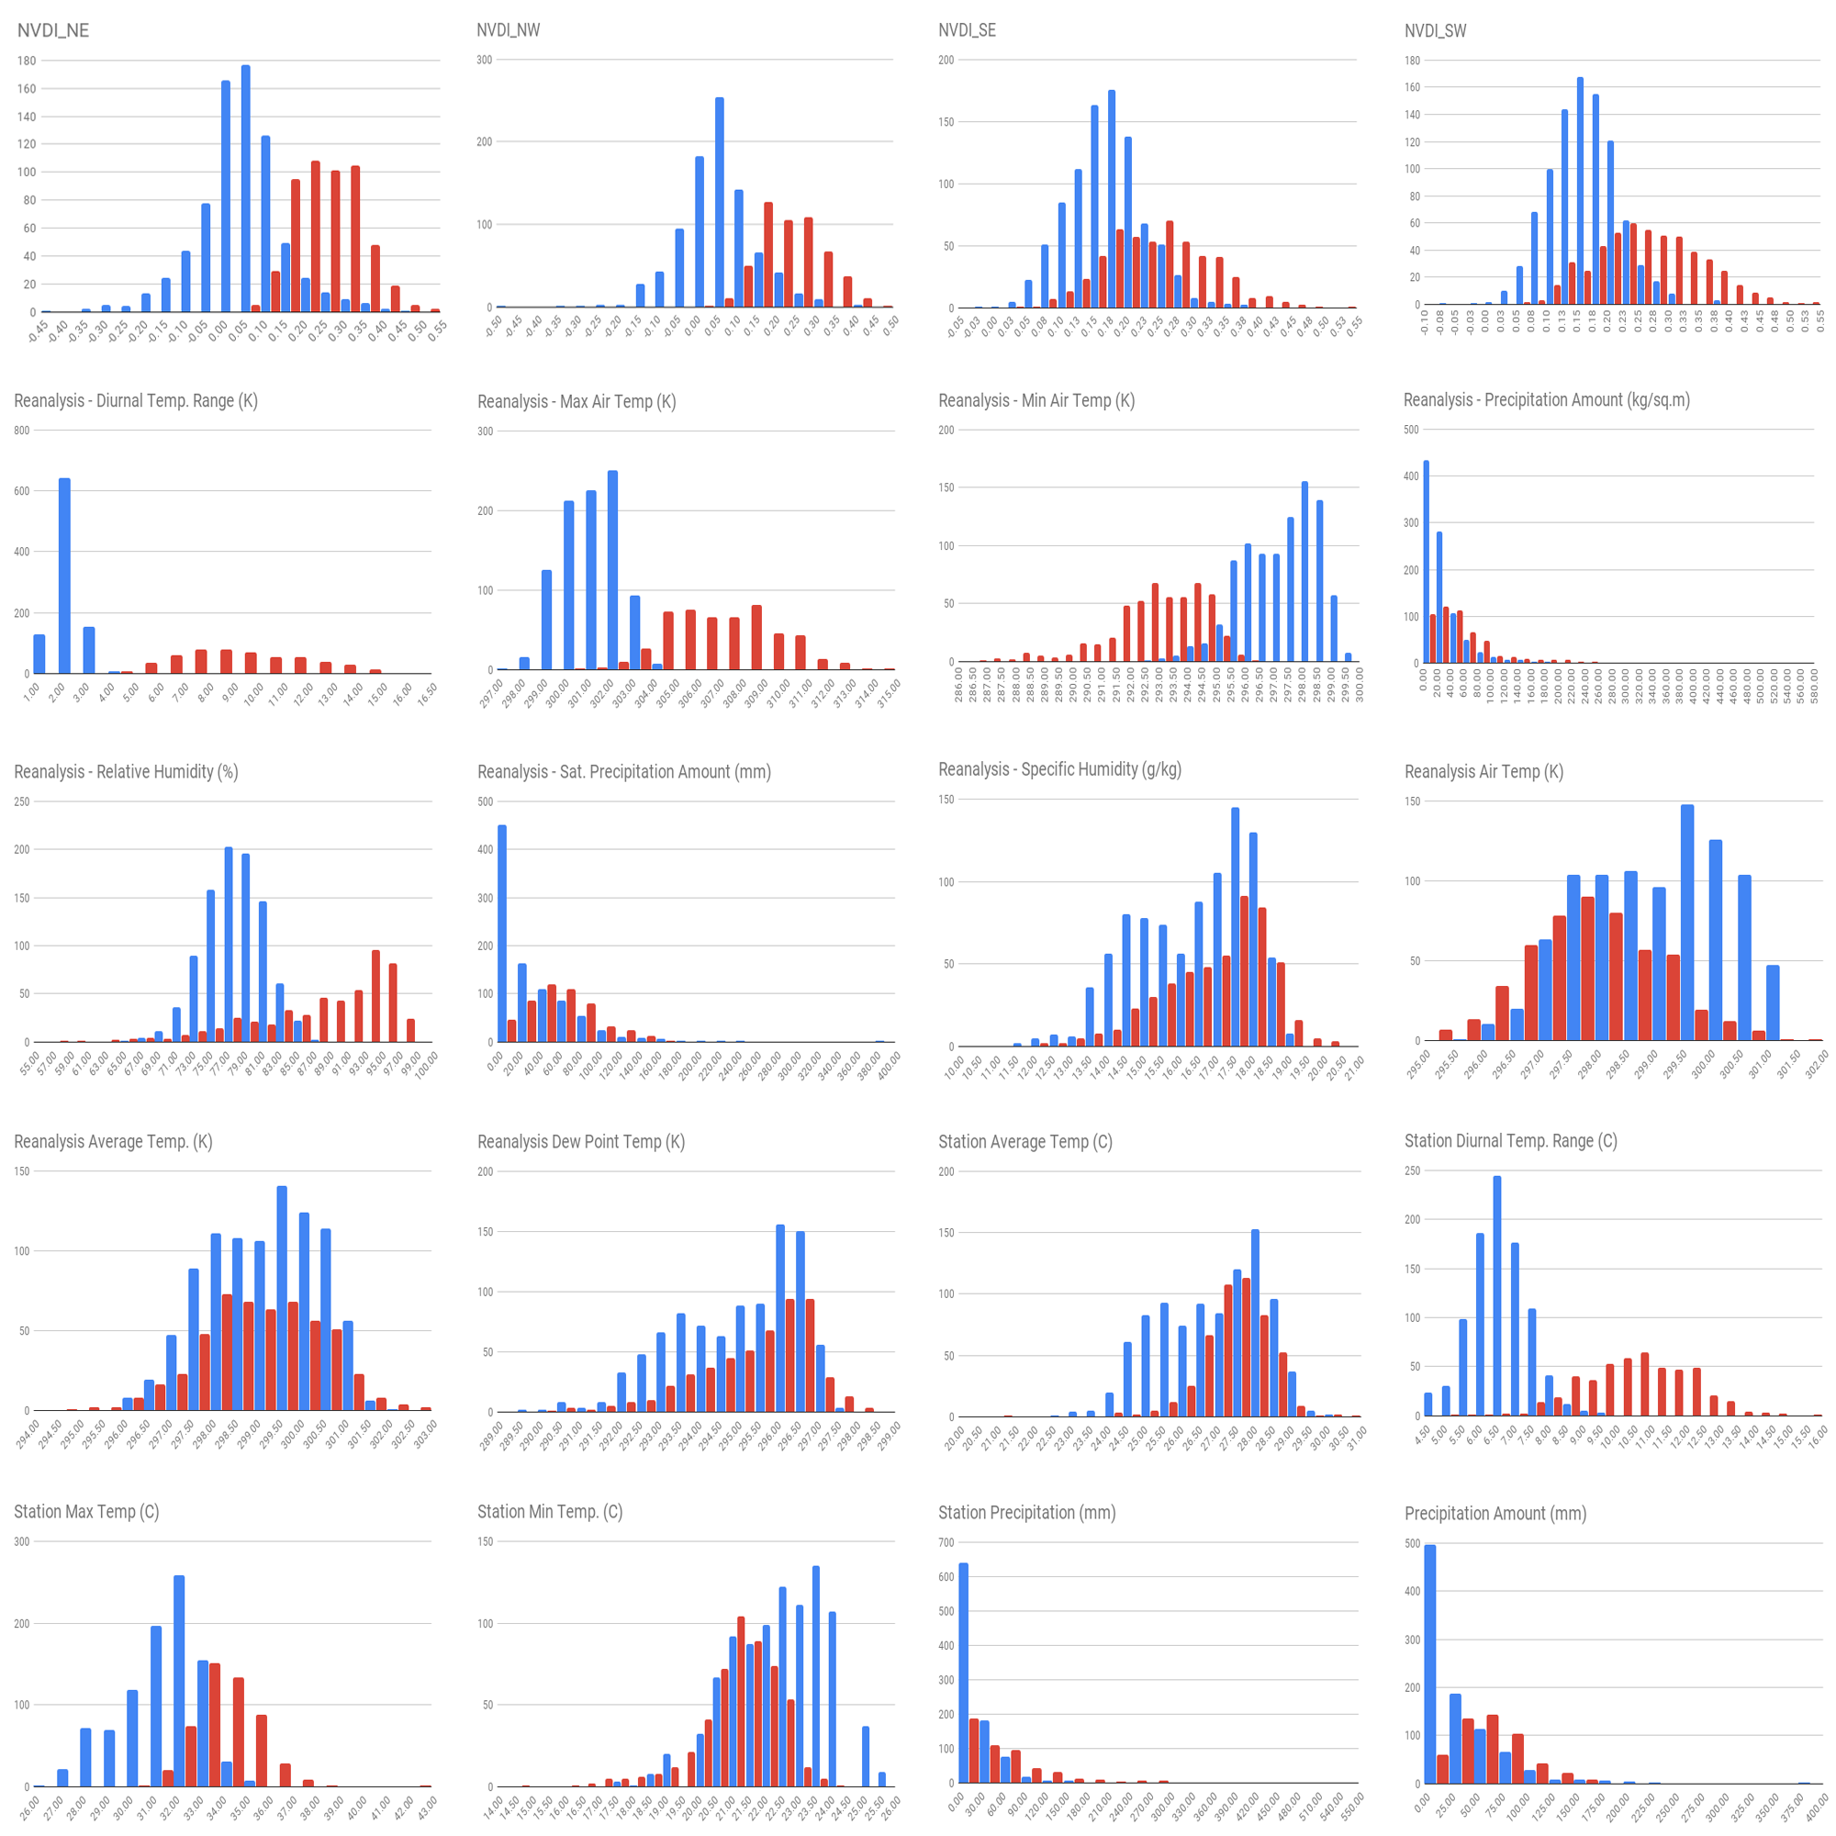
Data Analysis - Histogram

Slide 7

Feature Selection
Why?
Some features are redundant
Some features have a lot of missing values
Overfitting the model with all the features
Significant improvement in the accuracy !

Slide 8
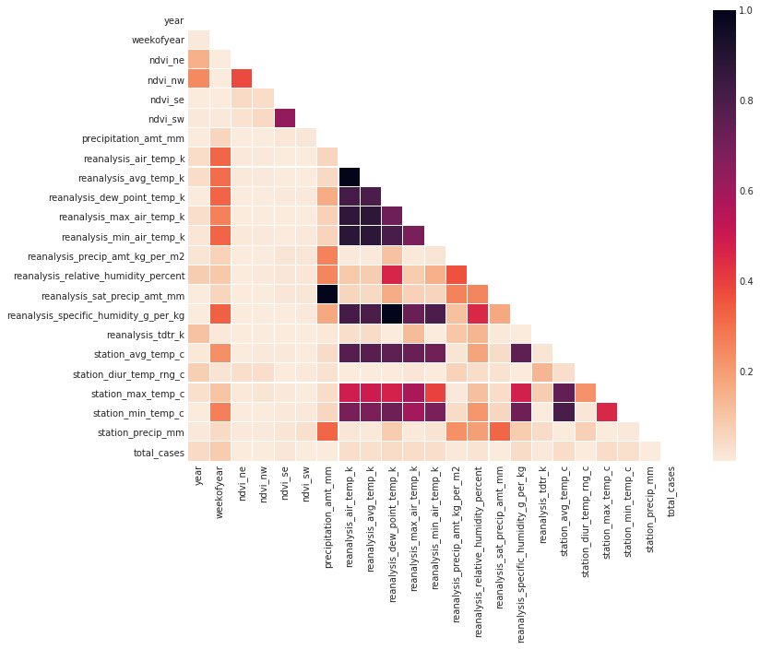
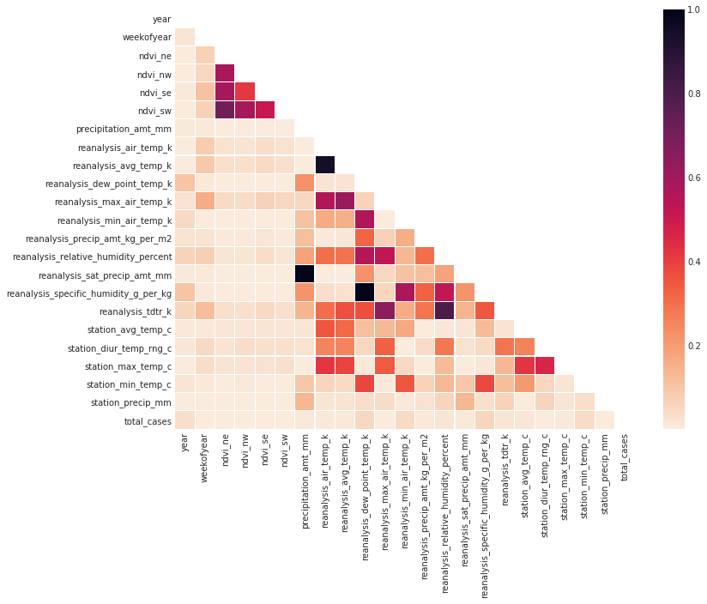
Feature Selection
Use correlation analysis
San Juan
Iquitos

Slide 9
Data
cleaning
Feature Engineering
Moving Averages
Take the moving average for some fields, this smooth out the data set
Quarter Breakdown
Using the time data find the quarter of data point and add as new feature
Filling missing values
Use backward filling to fill missing values
Time lagging
Some features were shifted in time

Slide 10
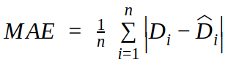
Model Implementation
Our target is reducing the MAE
Several models were implemented
Negative binomial regression
Random forest regression
ARIMA

Slide 11
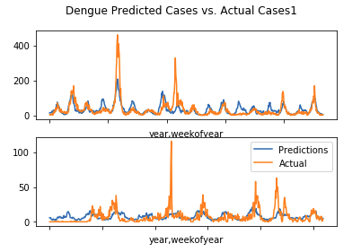
Negative Binomial Regression
Used as the baseline model.
Best MAE score of 24.1274.

Slide 12
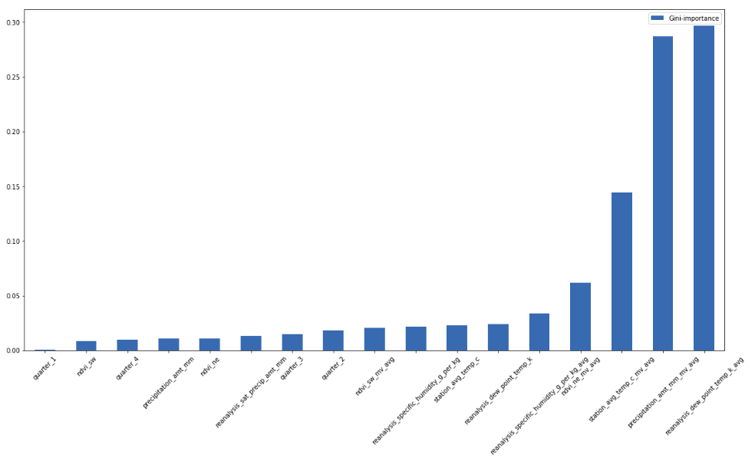
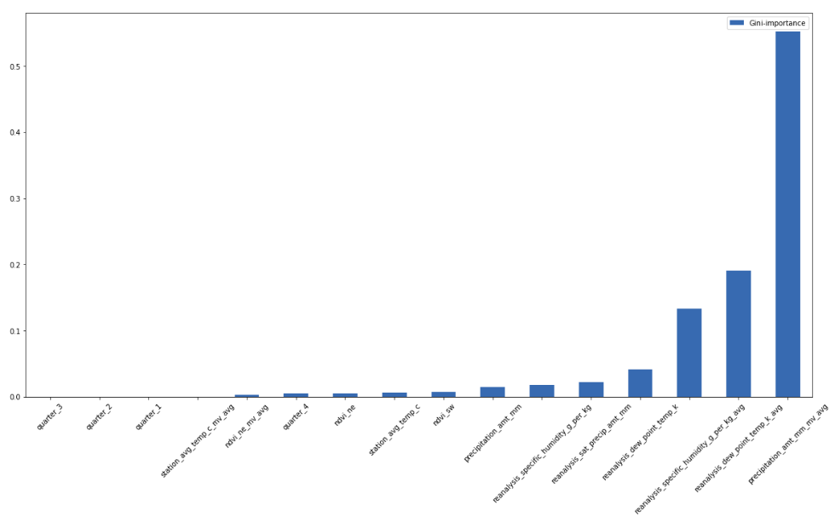
Random Forest Regressor
San Juan Feature Importance
Random forests is an ensemble learning method
Best result 17.8
Iquitos Feature Importance

Slide 13
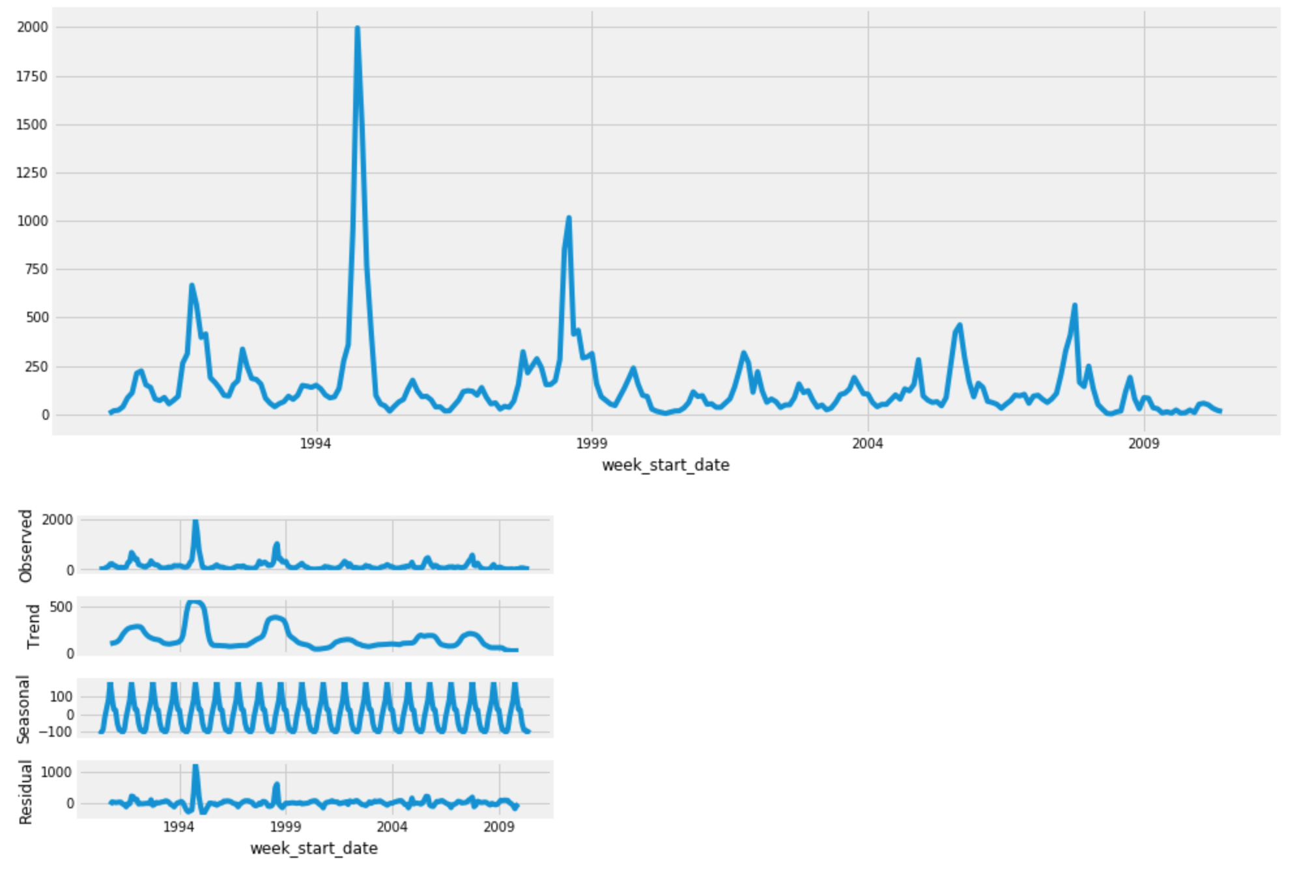
ARIMA
Time Series Forecasting with AutoRegressive Integrated Moving Average (ARIMA)
Uses time series analysis
Time series analysis

Slide 14
Results & Discussion
Importance of feature selection
Importance of feature engineering
Best performance was from Random Forest regressor.
Model | Cross Validation | Competition Result
Random Forest Regressor | 20.5 | 17.5
Negative Binomial | - | 24.1274
ARIMA | No submissions were made due to poor performance

Slide 15




Results & Discussion (Cont)
Machine learning, data visualization frameworks

Slide 16
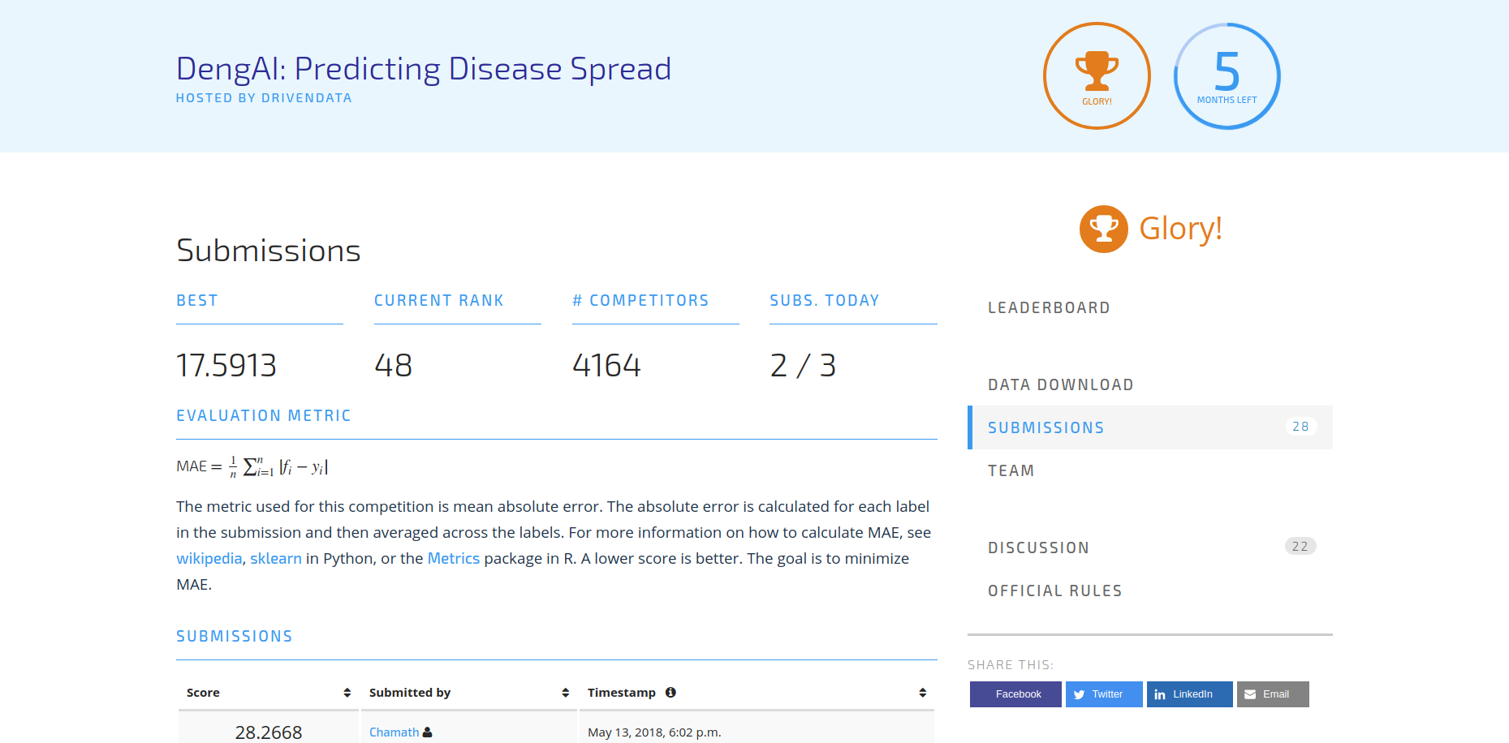
Results & Discussion (Cont)

Slide 17
Questions?

Slide 18
References
[1] Dengue Virus Net. [online] Denguevirusnet.com. Available at: http://www.denguevirusnet.com [Accessed 20 Jul. 2018].
[2] dengueforecasting.noaa.gov. (2018). Dengue Forecasting. [online] Available at: http://dengueforecasting.noaa.gov/ [Accessed 19 Jul. 2018].
[3] en.wikipedia.org. (2018). San Juan, Puerto Rico. [online] Available at: https://en.wikipedia.org/wiki/San_Juan,_Puerto_Rico#Geography [Accessed 19 Jul. 2018].
[4] en.wikipedia.org. (2018). Iquitos. [online] Available at: https://en.wikipedia.org/wiki/Iquitos#Geography [Accessed 19 Jul. 2018].
[5] DengAI: Predicting Disease Spread - Benchmark - DrivenData Labs. [online] Available at: http://drivendata.co/blog/dengue-benchmark/ [Accessed 20 Jul. 2018].
[6] Random forest. [online] Available at: https://en.wikipedia.org/wiki/Random_forest [Accessed 20 Jul. 2018].
[7] Autoregressive integrated moving average. [online] Available at: https://en.wikipedia.org/wiki/Autoregressive_integrated_moving_average [Accessed 20 Jul. 2018].
[8] How to Create an ARIMA Model for Time Series Forecasting with Python. [online] Machine Learning Mastery. Available at: https://machinelearningmastery.com/arima-for-time-series-forecasting-with-python/ [Accessed 20 Jul. 2018].
[9] statsmodels.tsa.statespace.sarimax.SARIMAX — statsmodels 0.9.0 documentation. [online] Available at: http://www.statsmodels.org/dev/generated/statsmodels.tsa.statespace.sarimax.SARIMAX.html [Accessed 20 Jul. 2018].

